Slide 1
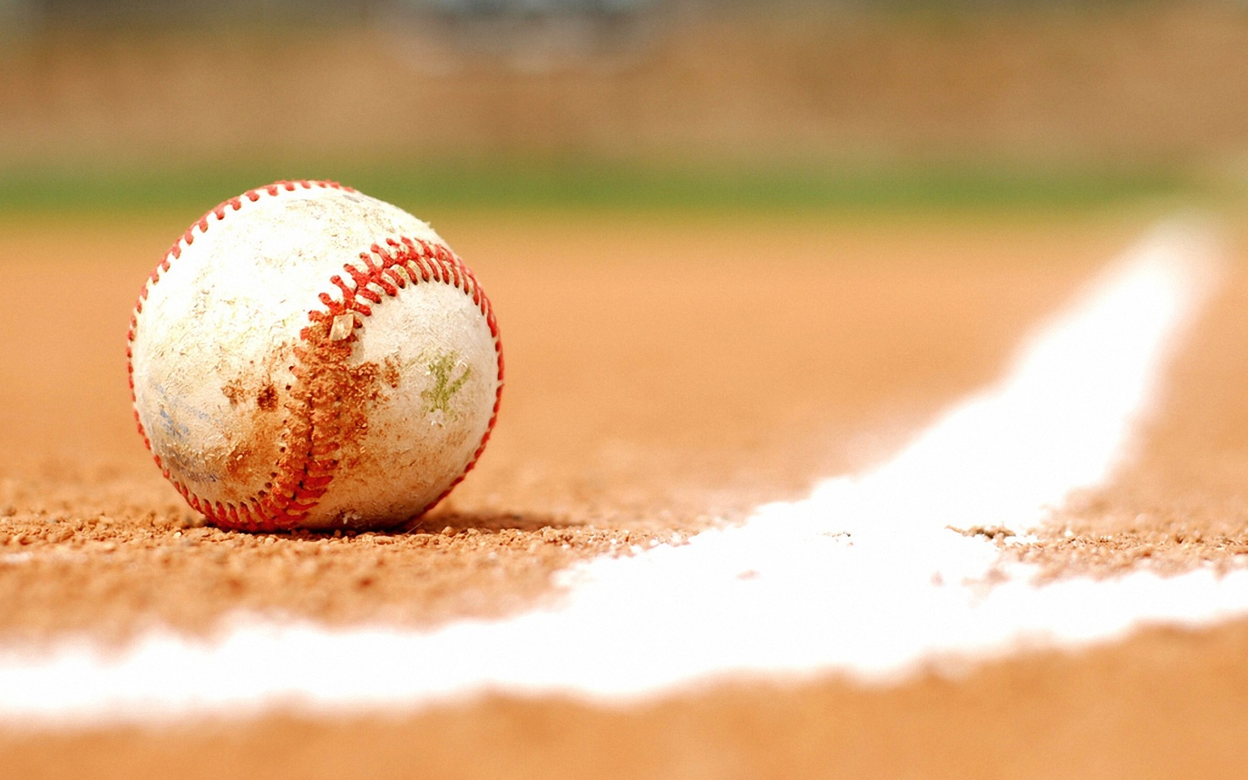
Mini Project MLB Shift Rule Analysis
By: Derek Chibbaro

Slide 2
Research Question and Background
My project analyzes the effects of the infield shift rule that was implemented at the start of the Major League Baseball (MLB) 2023 regular season.
I looked at the location of batted-balls in the infield across different seasons to see if there are any strategic differences in batter performances before vs after the rule change.
Background on MLB shift rule
According to the MLB, “defensive teams will be required to have a minimum of four players on the infield, with at least two infielders completely on either side of second base. These restrictions are intended to increase the batting average on balls in play, to allow infielders to better showcase their athleticism and to restore more traditional outcomes on batted balls.”
Research Question
Is there a correlation between where a ball is put into play and the change of the MLB shift rule? Do teams change their hitting strategies to optimize their success? Does the location of an MLB stadium impact a hitter’s decision on where they try to hit the baseball?

Slide 3
Tractable data
About this data:
I used data from pybaseball, which is a Python package for baseball data analysis that scrapes from Baseball Reference, Baseball Savant, and Fan Graphs to aggregate data and make it easy to run Python commands to analyze the data. It contains over 90 game level statistics.
Baseball Reference gets its data from a free, downloadable database that contains standard batting and pitching lines for every player.
Baseball Savant is the central location for Statcast data, which is collected using radar equipment and high-resolution cameras to track every movement on the field.

Slide 4
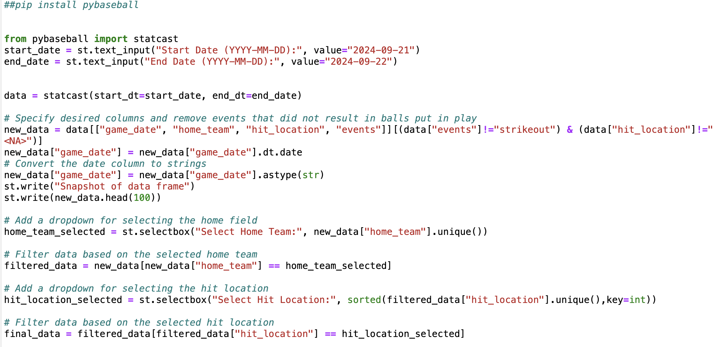
Data Retrieval
Easy to gain access to this free data...
pip install pybaseball package
Import statcast, then specify start and end dates that you want

Slide 5
Interacting with project
Use this link to test out my project for yourself!
baseballproject.streamlit.app

Slide 6
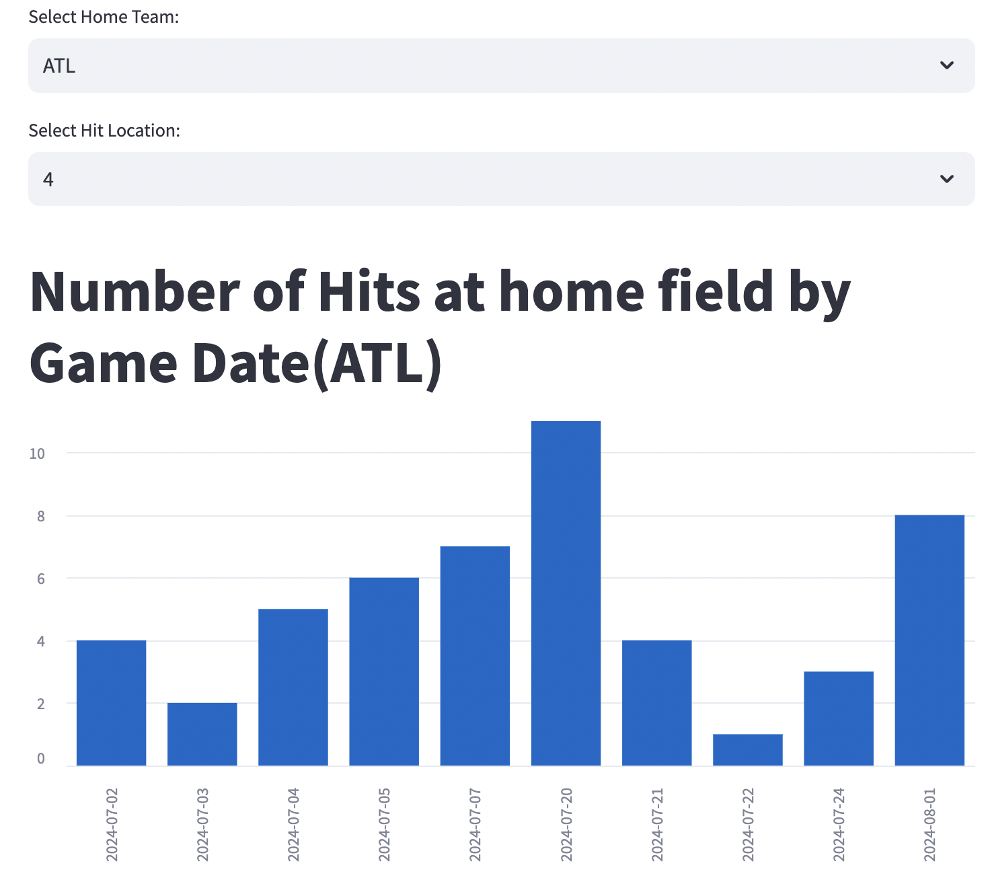
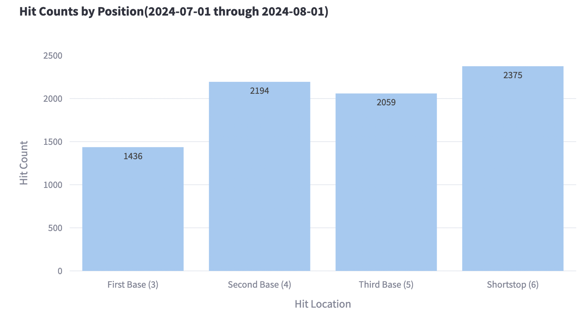
Methods for Exploratory Data Analysis
Bar graph with hit counts at specific position and home field
Total hit counts at infield positions
Percentage of batted balls hit to different positions
Future plans for analysis
Heat map with visuals of where balls were hit at certain positions to see where players are trying to optimize their best chance for reaching base safely.

Slide 7
Snapshots of Code
Importing/Cleaning data and creating selection boxes

Slide 8
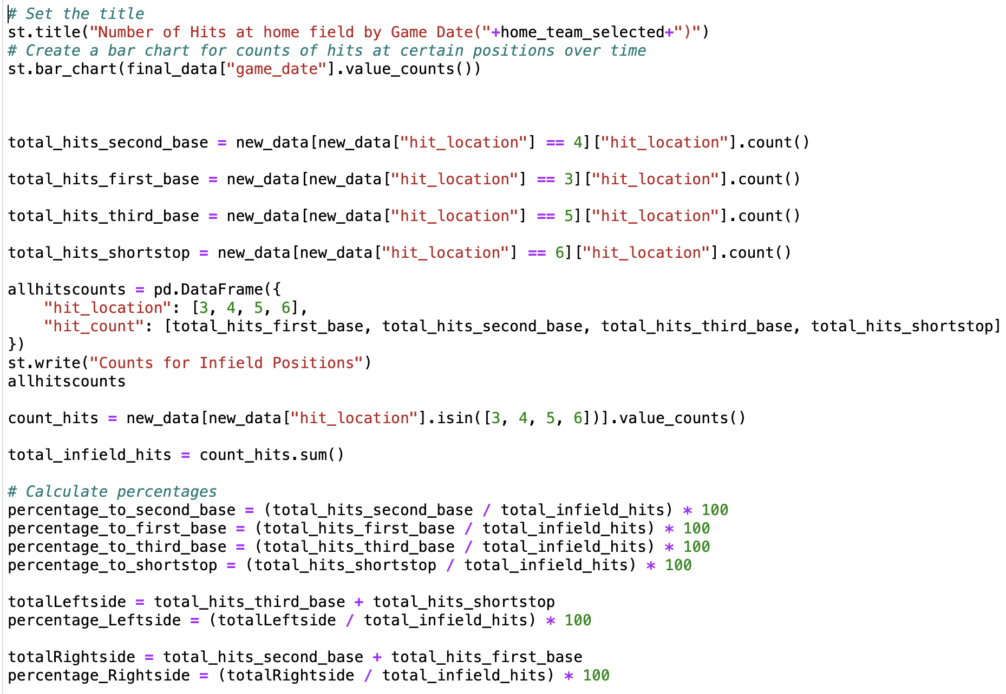
Snapshots of Code
Creating bar chart of hits over time, total hits at locations, and percentages

Slide 9
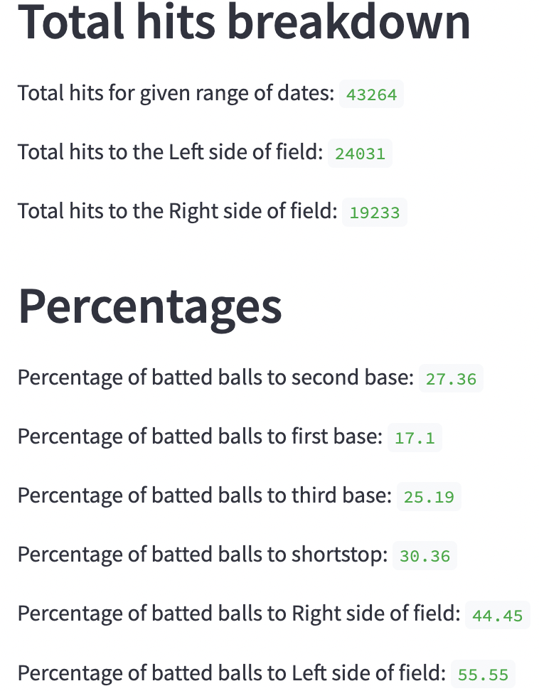
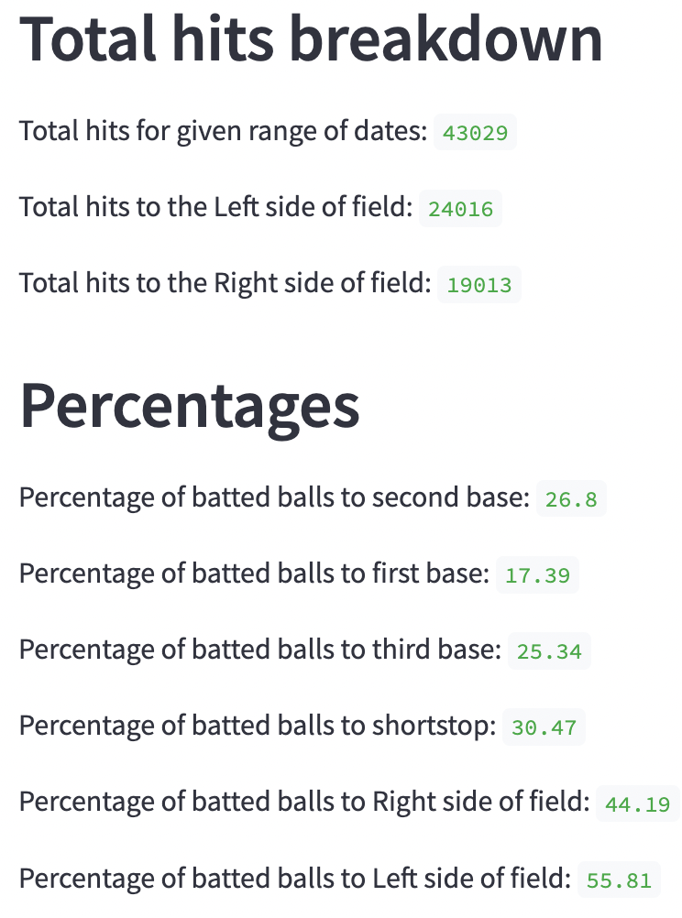
Findings (Before Rule Change)
Figure 1: April 1st, 2018 – August 31st, 2018
Figure 2: April 1st, 2019 – August 31st, 2019
Comparison:
Balls are hit slightly more to left side of field, most likely due to more right-handed hitters in the league.
Largest percentage hit to shortstop, smallest percentage hit to first base.

Slide 10
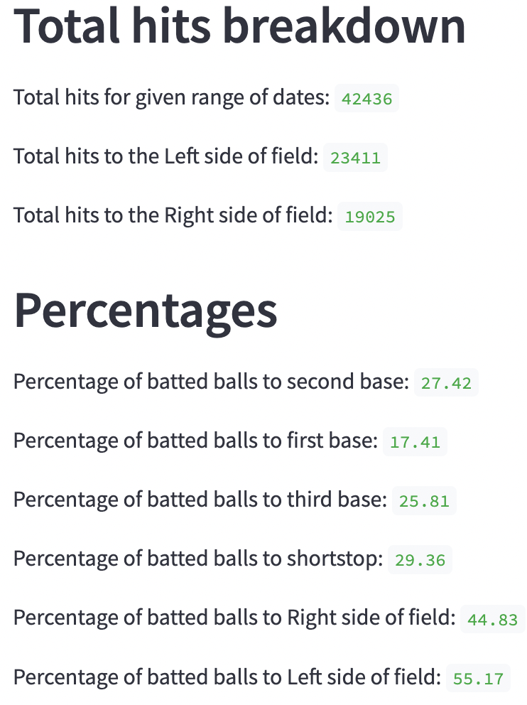
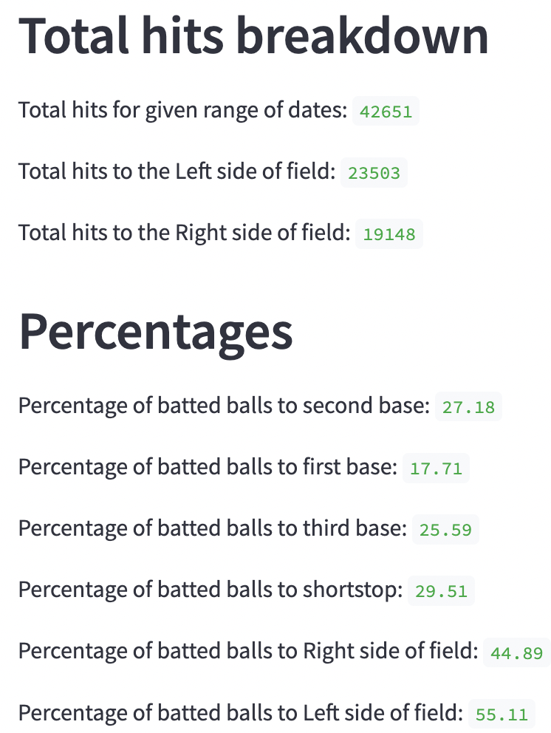
Findings (After Rule Change)
Figure 3: April 1st, 2023 – August 31st, 2023
Figure 4: April 1st, 2024 – August 31st, 2024
Comparison:
Balls hit more to left side of field (same as before rule change)
Largest percentage to shortstop (approx. 1% lower than before rule change), smallest percentage to first base

Slide 11
Overall Findings
There is no preliminary difference in the location of where a batted ball was hit in the infield. The approximate percentages for balls hit to second base, first base, third base, and shortstop are 27%, 17%, 25%, and 29% respectively.
This doesn't align with my initial prediction. Possible explanations could be that hitters don't tend to change their approach even with the rule change, or there are other factors that could be influencing the lack of change in percentages.

Slide 12
Implications for Stakeholders
The results from my project can be used by casual baseball fans to identify any trends related to the new shift rule. This rule can still impact the game in the future in ways we haven’t experienced yet, which can make this project even more interesting in years to come.
Coaches, managers, and owners of MLB teams could use these preliminary results when creating starting lineups (is the batter more likely to hit on right or left side?), or the location of the field could influence what players to draft in certain years to optimize the team's success.

Slide 13
Ethical, Legal, Societal Implications
This data is available for free to anyone who wants to use it for their own research and there are no intentions of selling these results. Baseball fans can better understand aspects of the game that are less obvious to a casual viewer, which can help the game’s fanbase as well.
Different teams could benefit more than others from the rule change based on field configurations or altitude levels (Colorado Rockies)
Pitchers who have high ground ball rates could be impacted (Logan Webb, San Francisco Giants)

Slide 14
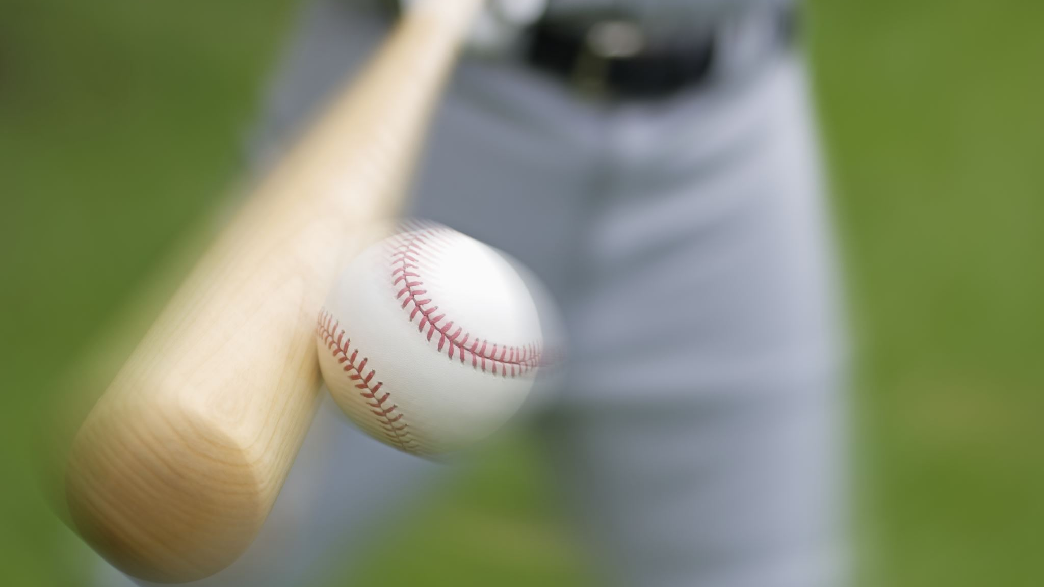
Thank you!

